Slide 1
Permutation Groups
MAYEESHA MUBASHIRA
IT23621

Slide 2
OUTLINE
Definitions and Notation​
Cycle Notation​
Transpositions​
Alternating Groups​

Slide 3
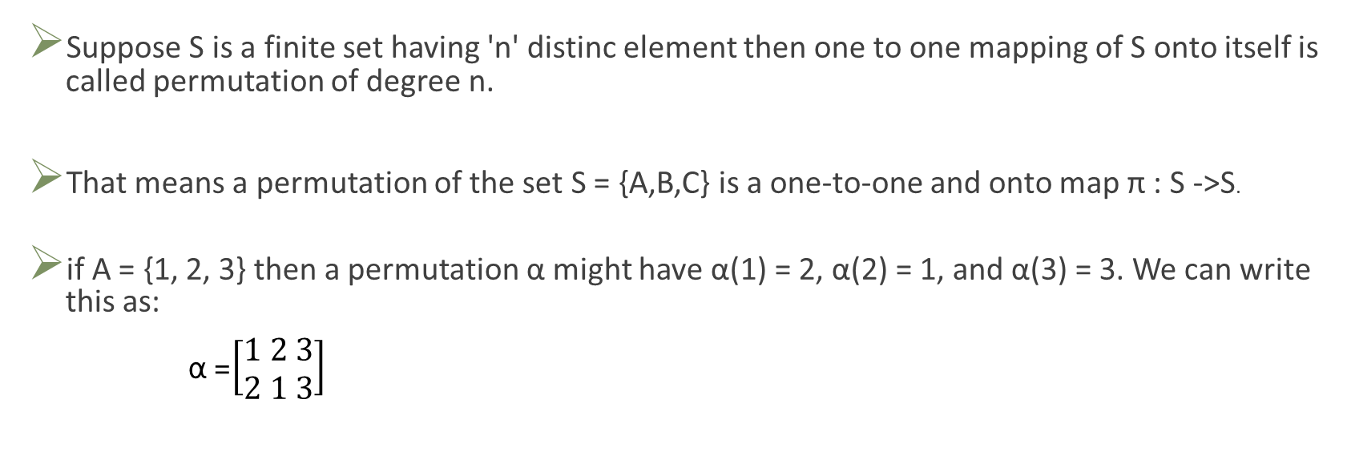
Definitions and Notation​
Suppose S is a finite set having 'n' distinc element then one to one mapping of S onto itself is called permutation of degree n.​
That means a permutation of the set S = {A,B,C} is a one-to-one and onto map π : S ->S.​
if A = {1, 2, 3} then a permutation α might have α(1) = 2, α(2) = 1, and α(3) = 3. We can write this as: ​
α =$\left[\begin{aligned}1 2 3 \\ 2 1 3\end{aligned}\right]$

Slide 4

Permutation multiplication is not usually commutative.
Let σ =$\left[\begin{aligned}1 2 3 4 \\ 4 1 2 3\end{aligned}\right]$
τ = $\left[\begin{aligned}1 2 3 4 \\ 2 1 4 3\end{aligned}\right]$
Then σ τ= $\left[\begin{aligned}1 2 3 4 \\ 1 4 3 2\end{aligned}\right]$
But τ σ =$\left[\begin{aligned}1 2 3 4 \\ 3 2 1 4\end{aligned}\right]$

Slide 5
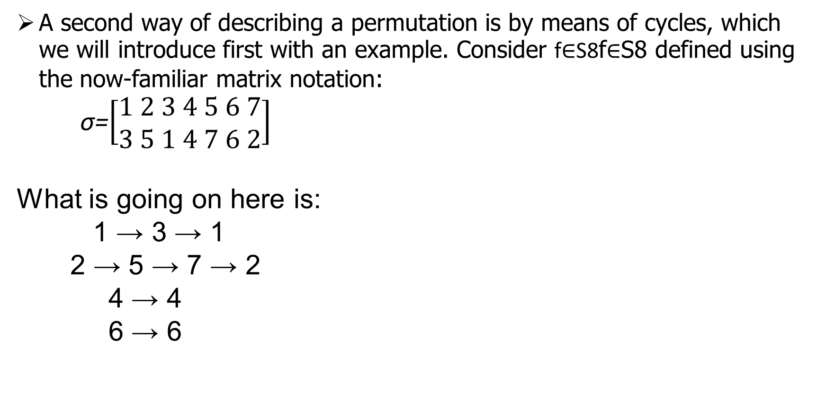
Cycle Notation ​
A second way of describing a permutation is by means of cycles, which we will introduce first with an example. Consider f∈S8f∈S8 defined using the now-familiar matrix notation:
σ=$\left[\begin{aligned}1 2 3 4 5 6 7 \\ 3 5 1 4 7 6 2\end{aligned}\right]$
What is going on here is:
1 → 3 → 1
2 → 5 → 7 → 2
4 → 4
6 → 6

Slide 6
We write: α = (1 3)(2 5 7)
notice that,
each parenthetical closes up as a cycle (a loop) and neither 4 nor 6 are mentioned because they are left alone.
Within each cycle we read from left-to-right and then cycle back to the start.

Slide 7
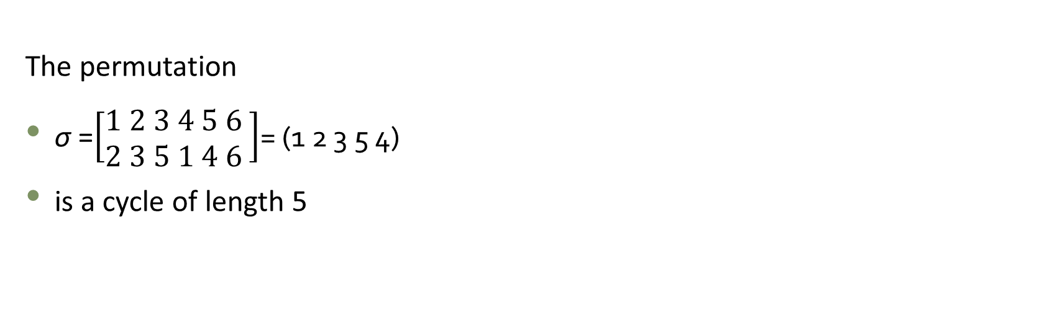
Example
The permutation
σ =$\left[\begin{aligned}1 2 3 4 5 6 \\ 2 3 5 1 4 6 \end{aligned}\right]$= (1 2 3 5 4)
is a cycle of length 5

Slide 8
2
3
5
4
1

Slide 9
Lets see another example to compute products of cycles. Suppose
that
σ = (1 3 5 2) and τ = (2 5 6).
If we think of σ as
1 →3, 3 →5, 5 → 2, 2 → 1,
and τ as
2 → 5, 5 → 6, 6 → 2,
then for στ remembering that we apply τ first and then
1 → 3, 3 → 5, 5 → 6, 6 → 2 → 1,

Slide 10
Transpositions​
The simplest permutation is a cycle of length 2. Such cycles are called
transpositions. Since
(a1, a2, . . . , an) = (a1, an)(a1, an−1) (a1, a3)(a1, a2),
Consider the permutation
(1 6)(2 5 3) = (1 6)(2 3)(2 5) = (1 6)(4 5)(2 3)(4 5)(2 5).
As we can see, there is no unique way to represent permutation as the
product of transpositions

Slide 11
Alternating Groups
One of the most important subgroups of Sn is the set of all even permutations,
An. The group An is called the alternating group on n letters.
A permutation is said to be even permutation if it can be expressed as a productof even transposition
(1 2 3)= (1 3) (1 2)=(1 2 3)
(1 2 3 4)=(1 4) (1 3) (1 2)

Slide 12
Thank You

